Slide 1


Final Year Project Proposal
Cricksense
AI-Based Cricket Ball Tracking and Bowling Performance Analysis System
Supervised By: Mr Nadeem Khan
Lecturer

Slide 2
Project Team
Nadeem ullah(56031)
Muhammad Umair (55779)
AI-Based Criket Ball Tracking and Bowing Performance Analysis System

Slide 3
Table of Content
Introduction and Background
Literature Review and Summary Table
  Gap Analysis
Problem Statement
Proposed Solution & Methodology
Project Scope
Work Breakdown Structure
Constraints & Limitations
AI-Based Criket Ball Tracking and Bowing Performance Analysis System

Slide 4
Introduction & Background
AI-Based Criket Ball Tracking and Bowing Performance Analysis System

Slide 5
Introduction And Background
Bowling depends on speed, swing, line, length, accuracy, and consistency.
We see normal cricket players don't use LBW because they don't have the technology for it.
Bowler dependend on coach for bowling analysis.
CrickSense uses a smartphone camera and AI to track the ball.
Analyzes speed, swing, line, length, pitch, and trajectory.
Provides potential LBW analysis using ball, pad, and wicket position.
Generates Delivery Quality & Wicket Threat Scores with AI feedback.
Stores session history to track player progress.
AI-Based Criket Ball Tracking and Bowing Performance Analysis System

Slide 6
Litrature Review
AI-Based Criket Ball Tracking and Bowing Performance Analysis System

Slide 7
Benchmarking
Functionality | Matcha | Kricket.ai | CrickX | Fulltrack AI | CrickSense (proposed)
Ball Tracking | ✓ | ✓ | ✓ | ✓ | ✓
Ball Speed | ✓ | ✓ | ✓ | ✓ | ✓
Ball Movement / Trajectory | ✓ | ✓ | ✓ | ✓ | ✓
Line & Length Analysis | ✓ | ✓ | ✓ | ✓ | ✓
Swing / Deviation | ✓ | ✓ | ✓ | ✓ | ✓
Pitch Location | — | ✓ | ✓ | ✓ | ✓
Delivery Quality Score | — | — | — | — | ✓
Wicket Threat Score | — | — | — | — | ✓
Potential LBW Analysis | — | — | ✓ | ✓ | ✓
AI Explanation | — | — | — | — | ✓
AI Recommendations | — | — | — | — | ✓
Session History & Comparison | ✓ | ✓ | ✓ | ✓ | ✓
Bowler fingerprint | — | — | — | — | ✓
AI-Based Criket Ball Tracking and Bowing Performance Analysis System

Slide 8
Gap Analysis
AI-Based Criket Ball Tracking and Bowing Performance Analysis System

Slide 9
Gap Analysis
Professional review systems (DRS, advanced LBW analysis) are expensive and inaccessible to amateur/practice players
Existing consumer cricket apps show measurements but don't explain why a delivery succeeded/failed
No affordable, camera-only solution combines: ball tracking + scoring + AI-based coaching feedback + session comparison
CrickSense fills this gap with a low-cost, smartphone-based, explainable AI approach
AI-Based Criket Ball Tracking and Bowing Performance Analysis System

Slide 10
Problem Statment
AI-Based Criket Ball Tracking and Bowing Performance Analysis System

Slide 11
Problem Statment
Developing bowlers lack access to professional analysis tools due to high cost
They rely on subjective coach/self-observation to identify issues in speed, line, length, swing, and consistency
This makes it difficult to accurately diagnose weaknesses or measure improvement over time
Need: an affordable, automated, and explainable bowling analysis system
Many of local player didn’t add LBW rules due to lack of tecnologies
AI-Based Criket Ball Tracking and Bowing Performance Analysis System

Slide 12
Proposed Solution & Methodology
AI-Based Criket Ball Tracking and Bowing Performance Analysis System

Slide 13
Proposed Solution and Methodology
Smartphone camera fixed behind the bowler/stumps captures deliveries
Computer Vision pipeline detects and tracks the ball across frames
System computes: ball speed, swing/deviation, line, length, pitch location, trajectory, and consistency
Derived metrics: Delivery Quality Score, Wicket Threat Score, potential LBW analysis
AI analysis layer converts raw metrics into plain-language feedback and improvement suggestions
Mobile application front-end displays results and historical session comparisons
AI-Based Criket Ball Tracking and Bowing Performance Analysis System

Slide 14
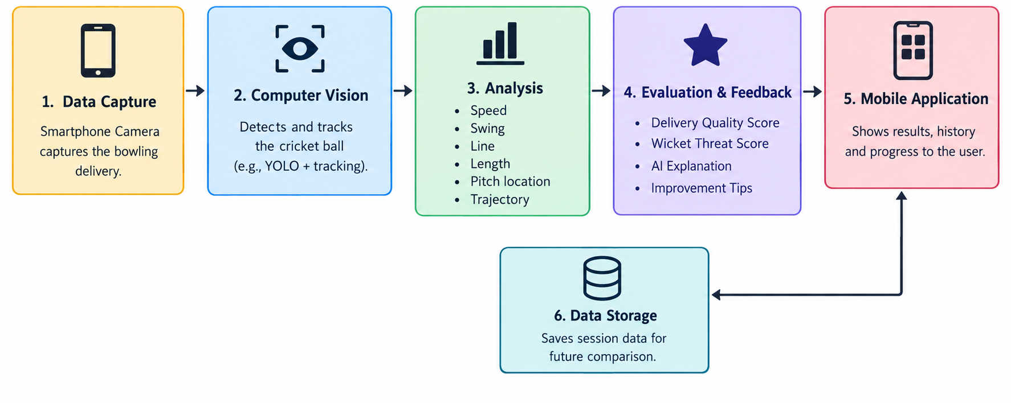
Methodology
Cricksense(workflow)
AI-Based Criket Ball Tracking and Bowing Performance Analysis System

Slide 15
Project Scope
AI-Based Criket Ball Tracking and Bowing Performance Analysis System

Slide 16
Project Scope
In scope: real-time video processing, ball tracking, bowling performance measurement, pad/wicket analysis, delivery scoring, AI feedback, bowler profile, session management, performance tracking, best-delivery identification, automated reports
Core features: ball detection/tracking, speed estimation, swing analysis, line/length analysis, pitch map, trajectory
Advanced features: Quality/Threat/Consistency scores, Bowler Fingerprint, Best Delivery Finder with auto-clip, LBW analysis, AI recommendations, session history
AI-Based Criket Ball Tracking and Bowing Performance Analysis System

Slide 17
Work Breakdown Structure
AI-Based Criket Ball Tracking and Bowing Performance Analysis System

Slide 18
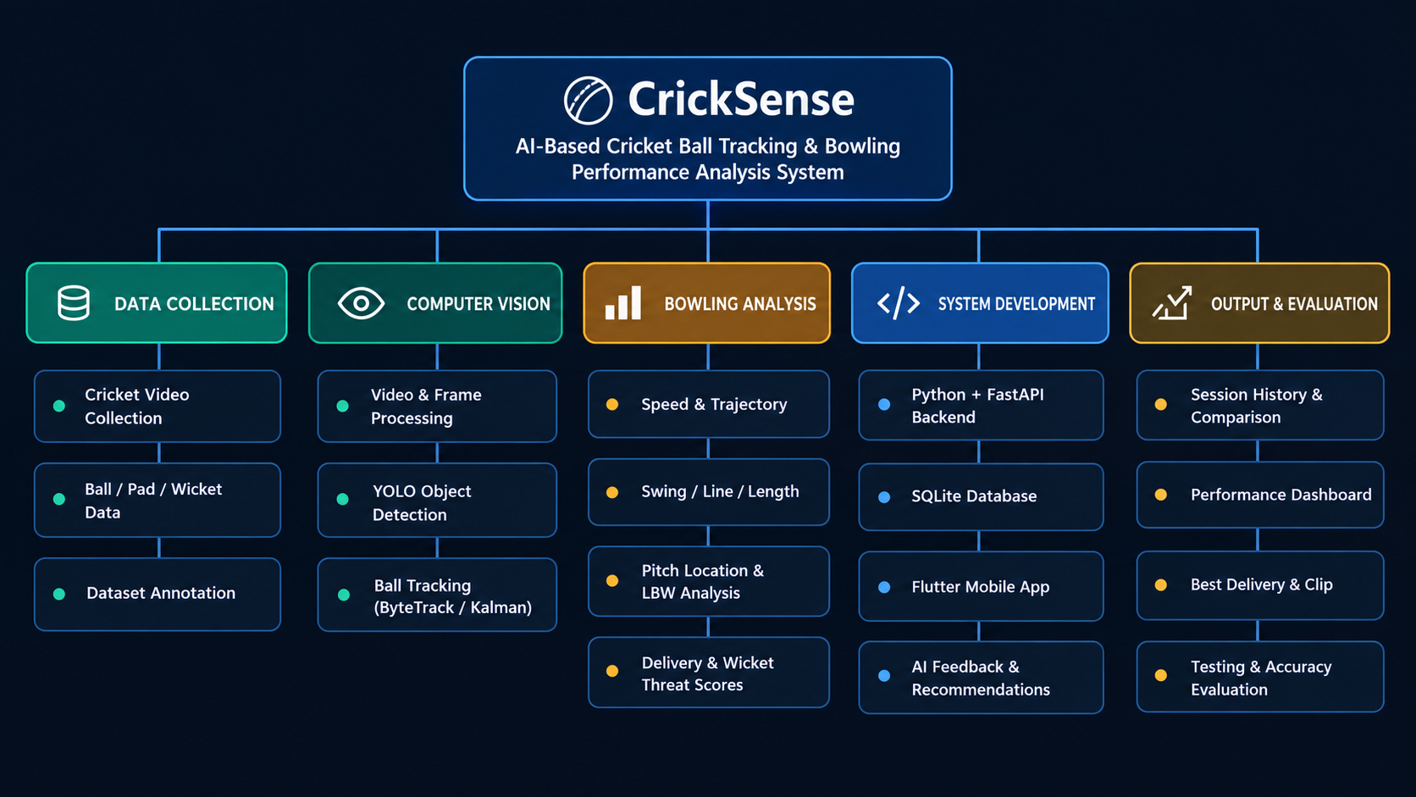
Work Breakdown Structure
AI-Based Criket Ball Tracking and Bowing Performance Analysis System

Slide 19
Constraints & Limitations
AI-Based Criket Ball Tracking and Bowing Performance Analysis System

Slide 20
Constraints and Limitations
System Limitations
Accuracy depends on good lighting and clear background
Motion blur at high ball speeds can affect precision
Wicket Threat/LBW scores are estimates
Model performance limited by training data variety
Intended to support match-play LBW review, but not a replacement for official DRS technology
Constraints
Single fixed camera (no multi-camera setup like Hawk-Eye)
No access to professional broadcast footage/datasets
No budget for radar or motion-capture equipment
AI-Based Criket Ball Tracking and Bowing Performance Analysis System

Slide 21
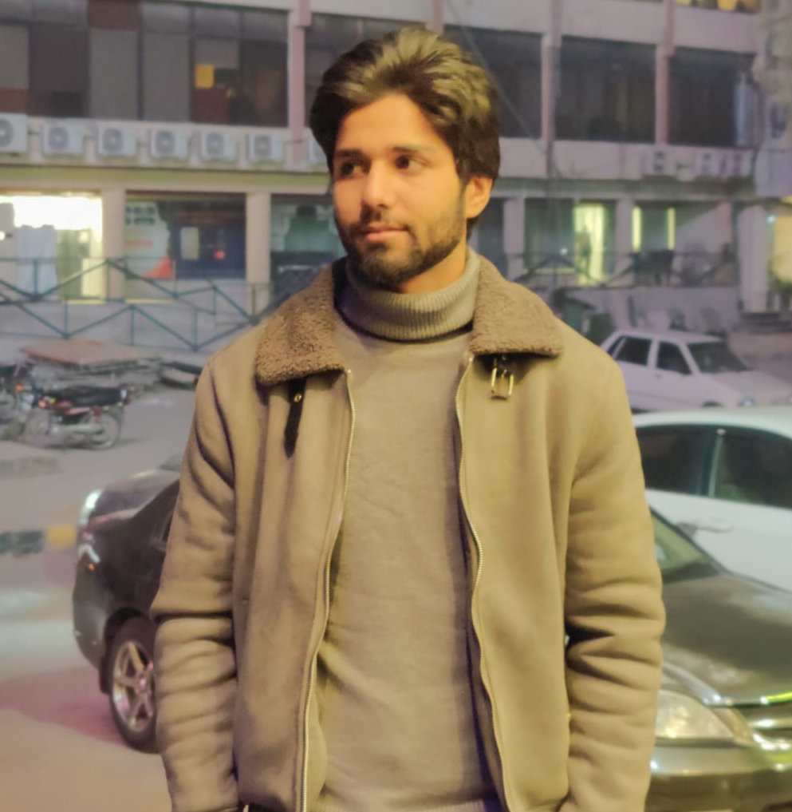
Roles
Nadeem ullah – Team Leader & Developer
BS Computer Science
Riphah International University, Islamabad
Contact No.: +92 3185201218
Email Address: 56031@students.riphah.edu.pk
Contribution(s)
Selected and responsible for the Backend, Model train Database.
Selected and responsible for the Integration of the Backend and Database.
AI-Based Criket Ball Tracking and Bowing Performance Analysis System

Slide 22
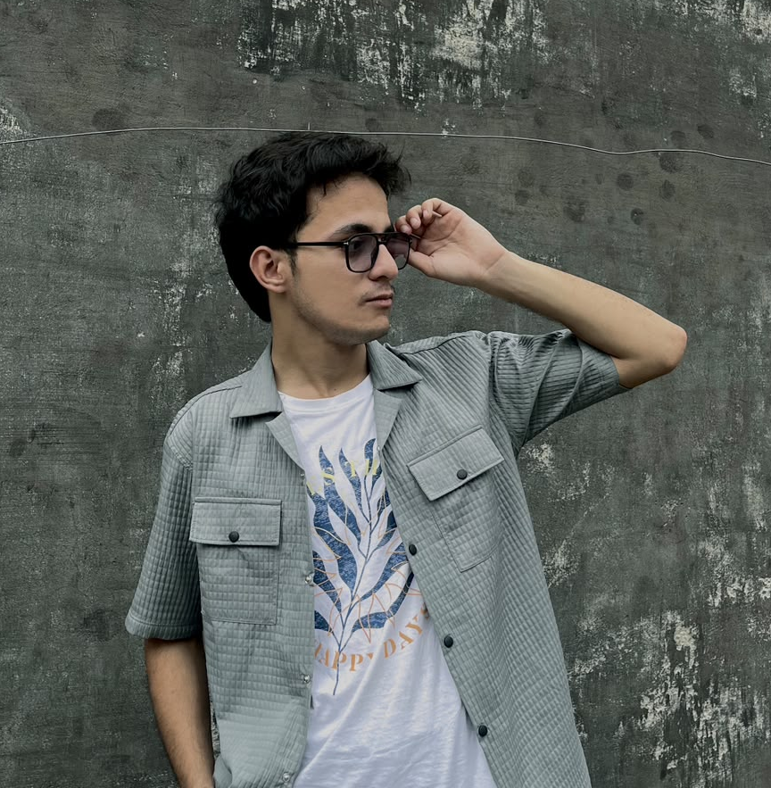
Roles
Muhammad Umair – Developer
BS Computer Science
Riphah International University, Islamabad
Contact No.: +92 3165366937
Email Address: 55779@students.riphah.edu.pk
Contribution(s)
Selected and responsible for the Frontend Application Development and help to Train Dataset.
Selected and responsible for the Application Integration.
AI-Based Criket Ball Tracking and Bowing Performance Analysis System

Slide 23
Thank You
  Any Suggestions !
AI-Based Criket Ball Tracking and Bowing Performance Analysis System

